Slide 1
30122 Final Project: How COVID-19 Influences Job Interview Behaviors
March 9, 2022
Baotong Zhang, Guangyuan Chen, Sophie Wang, Zhe Zhang

Slide 2
Project Overview
Goal
- Driven by curiosity
- Hypothesis: Job interview behaviors may have changed due to the pandemic
- Specifically look at interview questions
Methods
- Web scraping
- Text analysis
- Data visualization
Why should we care?
Social Science Implication: This project studies a social phenomenon influenced by COVID-19, in the context of workplace and operational management.

Slide 3

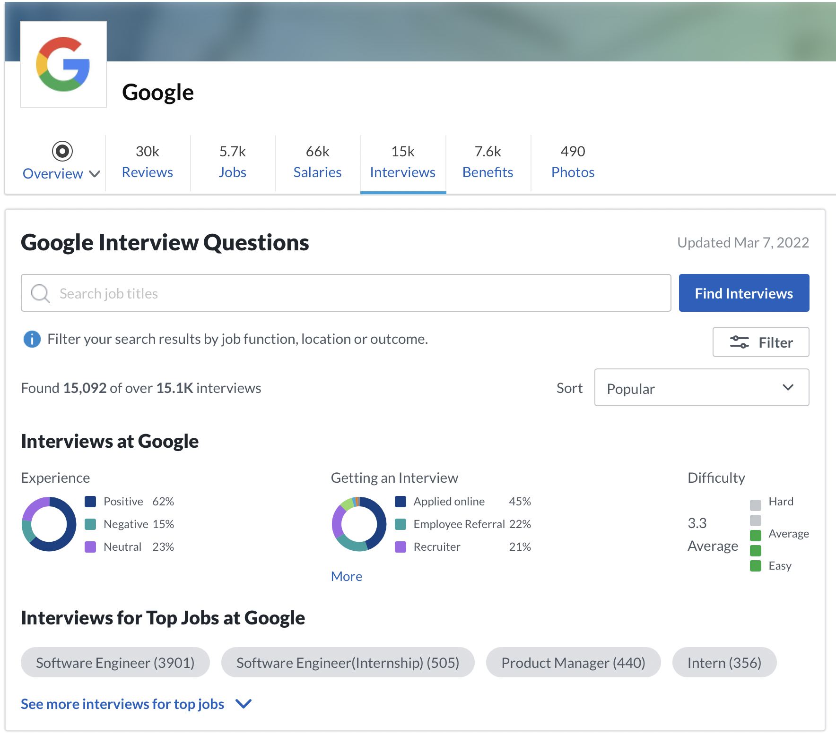
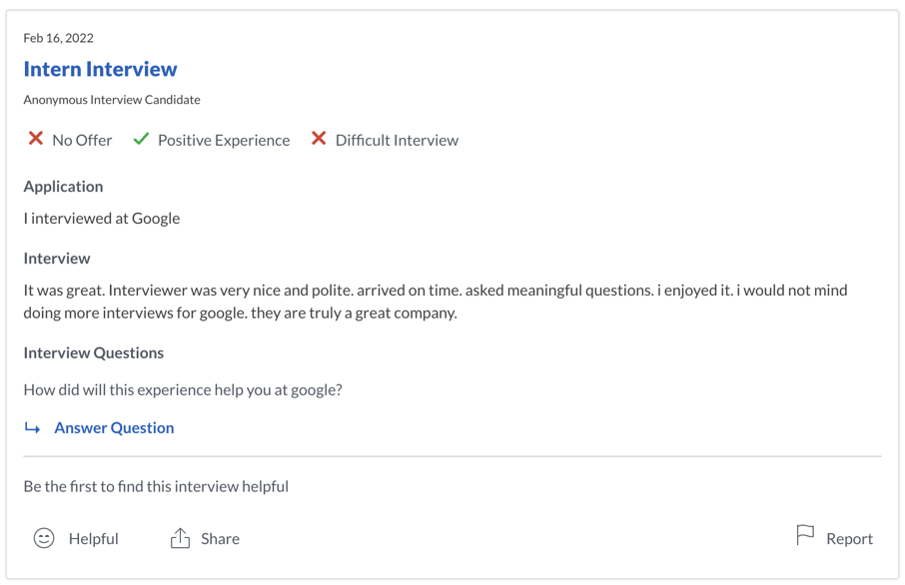
A Closer Look of Our Data…
Source 1 - Glassdoor: find interview questions
- Didn’t use existing statistics as we seek to analyze something new
- Company name → Interviews → Interview & interview questions (why?)

Slide 4

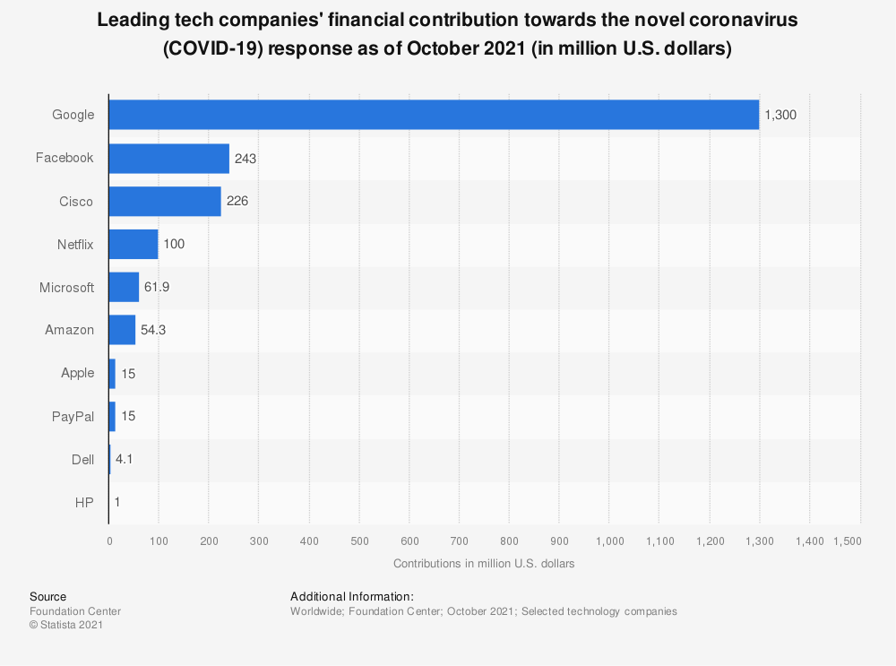
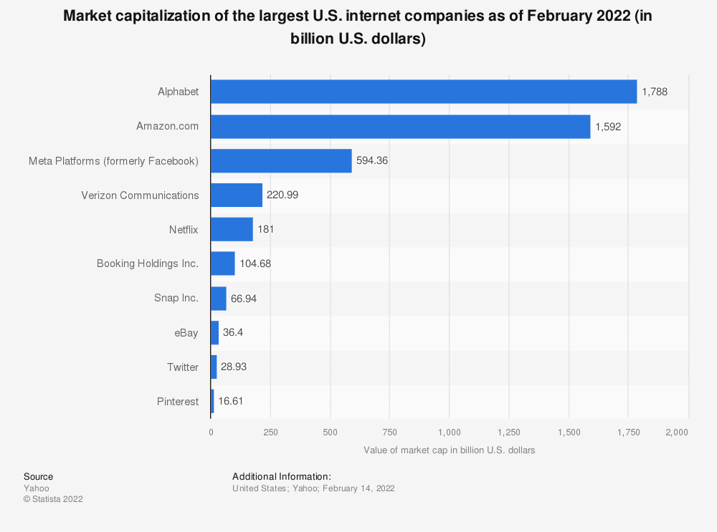
A Closer Look of Our Data…
Source 2 - Statista: find targeted companies
- Our benchmark: Tech giants that appeared in both graphs
- Our choice: Google, Meta (formerly Facebook), Amazon, and Netflix

Slide 5
Data Collection
Sample Size
- Data entry: each targeted post on Glassdoor
- From 2009/3/11 to 2020/2/1: 43k
- From 2020/2/1 to 2022/2/23: 22k
Challenges
1. Need to login to scrape data from Glassdoor. Very hard to “login” in the code 2. Data isn’t sorted by date. Can’t do time series analysis directly
Our solutions
1. login from the browser and put the cookies into the header 2. We added a sorting parameter
Total: 65k

Slide 6
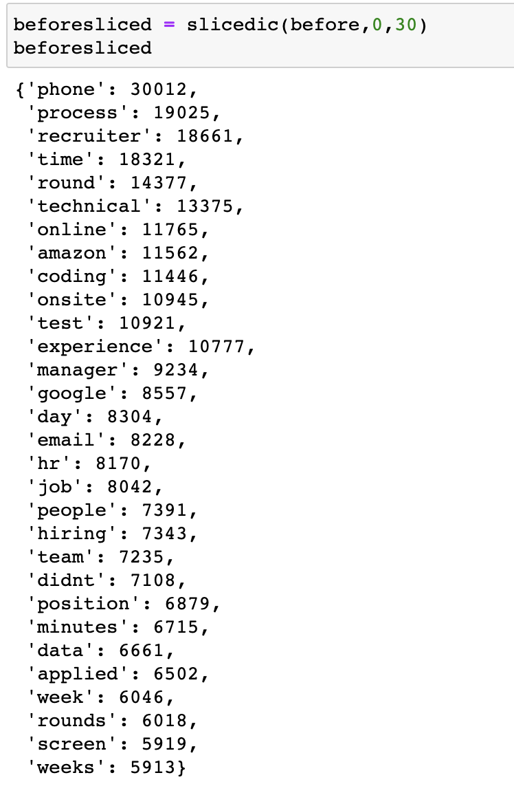
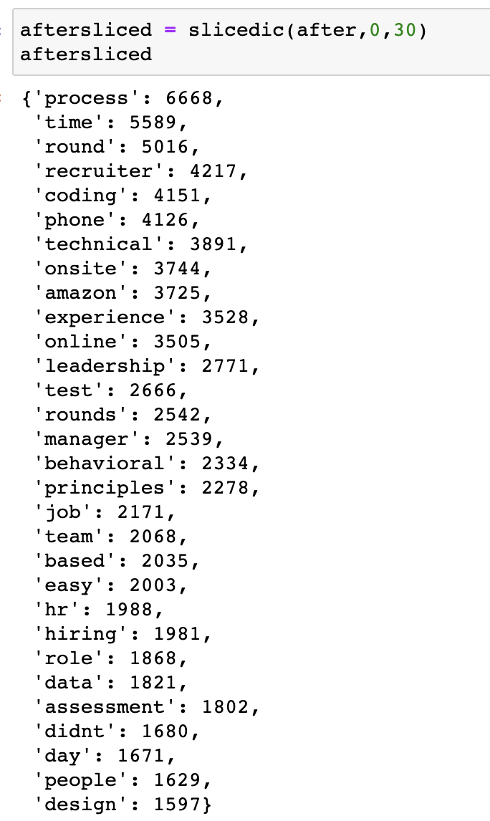
Data Cleaning & Processing
Data Cleaning
Turn the text into a list of words (tokenization)
Remove punctuation
Eliminate a word if stripping the punctuation from it yields the empty string
Convert the word to lower case
Eliminate all stop words
Remove URLs and hashtags
Remove characters from foreign languages
Data Processing
Count word frequency
Form a ranking
Word Frequency Statistics before/after February 1st (top 30)
Used Packages
Pandas, Numpy
Matplotlib, Seaborn
Beautifulsoup, Requests, re
Sklearn, Gensim
WordCloud
Notes:
When we finish the data collection section, we move on to the Data Cleaning and processing section
As you can see.
There are three columns of our raw data, namely by date, interview and question.
Listed above are our data cleansing steps. It is worth mentioning that when cleaning up non-English letters, since German and French also contain some English letters, it is possible that we did not successfully clean up all the posts in these languages. Although the result does not affected for this time, we believe that the successful cleaning will make our data more accurate.
in data process part
Because we found that the difference between the interview column and question column is not that big. as mentioned above, not everyone input information in strict accordance with the format required by the website.so In the process, interview and question are put together.
First Count word frequency
Then we Form a ranking
These are the top 30 word frequencies we formed before/after February 1st We'll explain that in more detail later

Slide 7
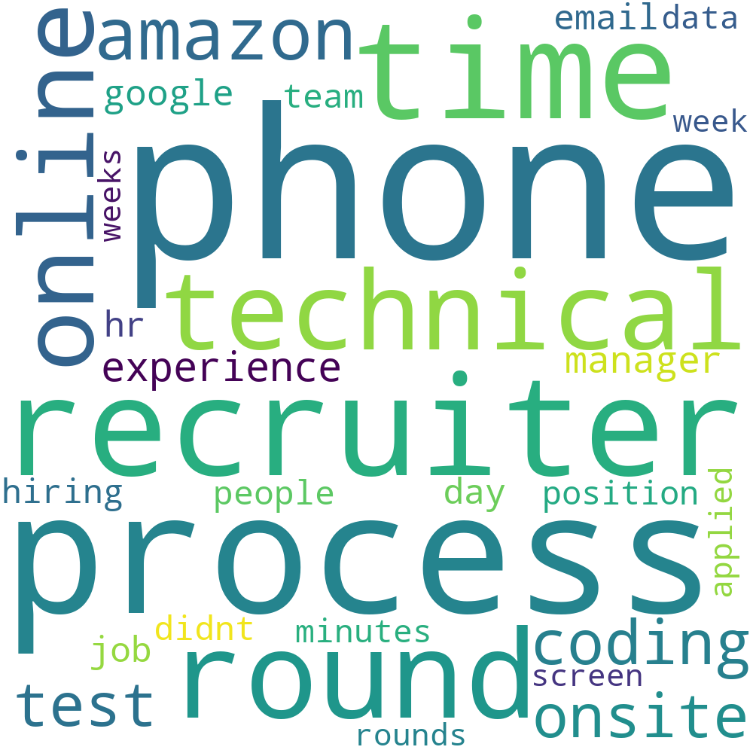
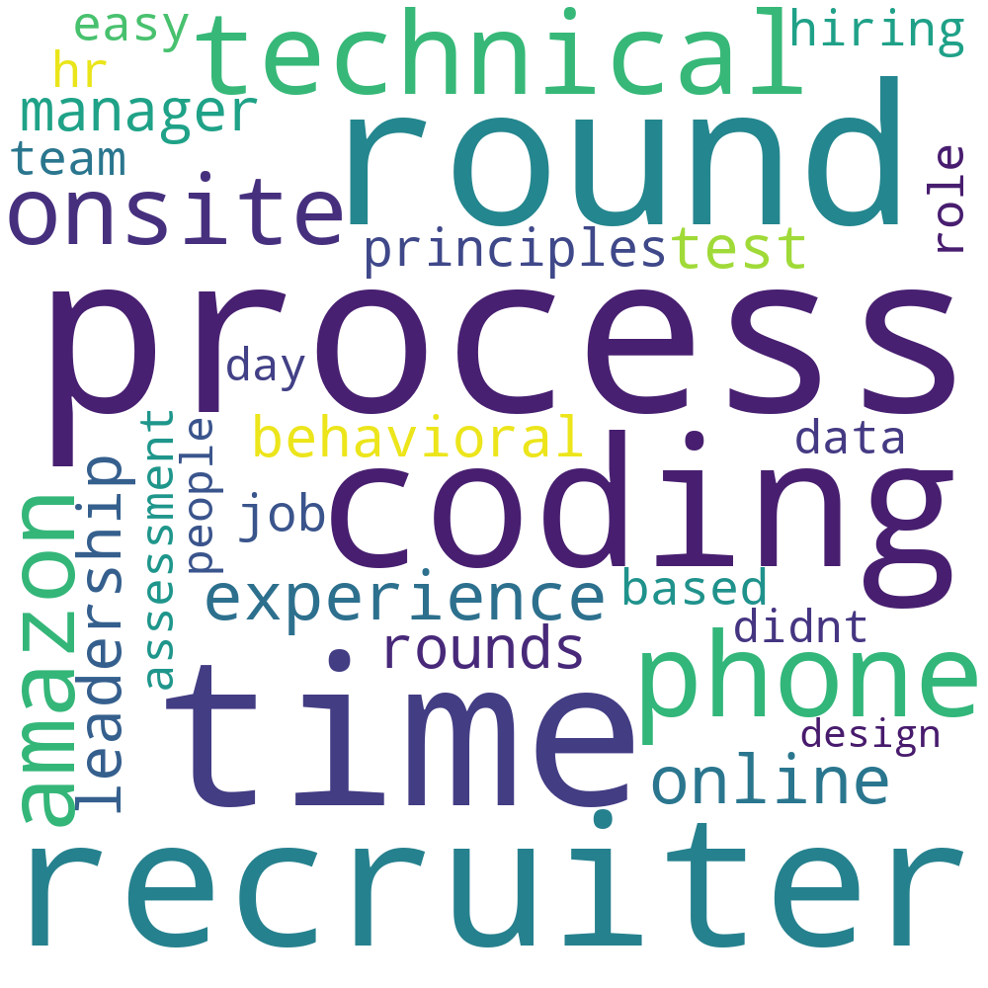
Data Visualization：Word cloud
2009/3/11-2020/2/1
2020/2/1-2022/2/23
Notes:
下一页
We ended up with a word cloud that represented some of the things that were important to the interviews before and after February 1st.
In fact, in terms of first impressions, There was little change in the frequency of words, which may indicate that the impact of COVID-19 on tech companies is real but not that huge, .
That is different from what we first thought

Slide 8
Data Analysis - Absolute Ranking Values
Top 10 keywords BEFORE: (count of occurrence)
Phone (30,012)
Process (19,025)
Recruiter (18,661)
Time (18,321)
Round (14,377)
Technical (13,375)
Online (11,765)
Amazon (11,562)
Coding (11,446)
Onsite (10,945)
Top 10 keywords AFTER:
(count of occurrence)
Process (666,8)
Time (5,589)
Round (5,016)
Recruiter (4,217)
Coding (4,151)
Phone (4,126)
Technical (3,891)
Onsite (3,744)
Amazon (3,725)
Experience (3,528)
Finding：
Frequency of "phone” has been very high, no matter before or after the COVID-19.
Notes:
下一页
But we can see it in the top 10 words, the frequency of the word "phone" has been very high, no matter before or after the COVID-19. Which means Mobile apps have always been the main development direction of these companies since 2009.

Slide 9
Data Analysis - Relative Ranking Values
Findings：
“Onsite”/ “No Onsite” ?
“Video interview” It is being used as an effective interview tool by the company
“Team” & “leadership” ：
Cooperation among colleagues is becoming more and more important, and leadership is an important criterion for companies to measure
Ranking changes (In descending order after COVID)
Word | Rank Before Covid | Rank After Covid | Rank Up Value
Coding | 9th | 5th | 4
Onsite | 10th | 8th | 2
Leadership | 43rd | 12nd | 31
Team | 21st | 19th | 2
Feedback | 57th | 42nd | 15
Video | 81st | 60th | 21
Notes:
the next step We expanded our study of word frequency changes to the top 100 words, and we found that these changes were notable.
The word onsite has moved up two places, perhaps it is a sign that companies are thinking about commute issues after the pandemic. But because we only analyzed individual words, we can't be sure whether companies are consider more about onsite or just emphasizes that employer can be not onsite
Video has Up 21 places in the rank. According to the comparison we made in the data file, we found that many behavioral interview questions mentioned improvements to video interview. This may be an area where these companies are looking at.
Both team and leadership‘s rank have improved to varying degrees, which proves that interpersonal cooperation is more important in these company and leadership is an important criterion for companies to measure. However, since it always been important, we are not completely sure that this is due to the impact of the epidemic.

Slide 10

Implications
The current COVID-19 pandemic has changed many aspects of our life, including the traditional working environment
- fewer onsite requirements, more WFH
~ 22k data entries in the past two years (people rely on and use internet more)
- People need and use internet more than ever since the pandemic

Slide 11
Our Reflections
What can be done/could’ve been done for improvements?
- We picked tech companies
- Have a more specified list of stop words (currently we used the existing one in the Python package)
- May have new findings using sentiment analysis or n-grams
What are our biggest takeaways from this project?
- Computational methods can provide insights to social science studies
- Allow data to speak for itself

Slide 12
THANK YOU FOR LISTENING!
Baotong Zhang
Guangyuan Chen
Sophie Wang
Zhe Zhang

